Slide 1
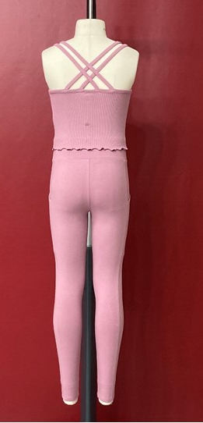
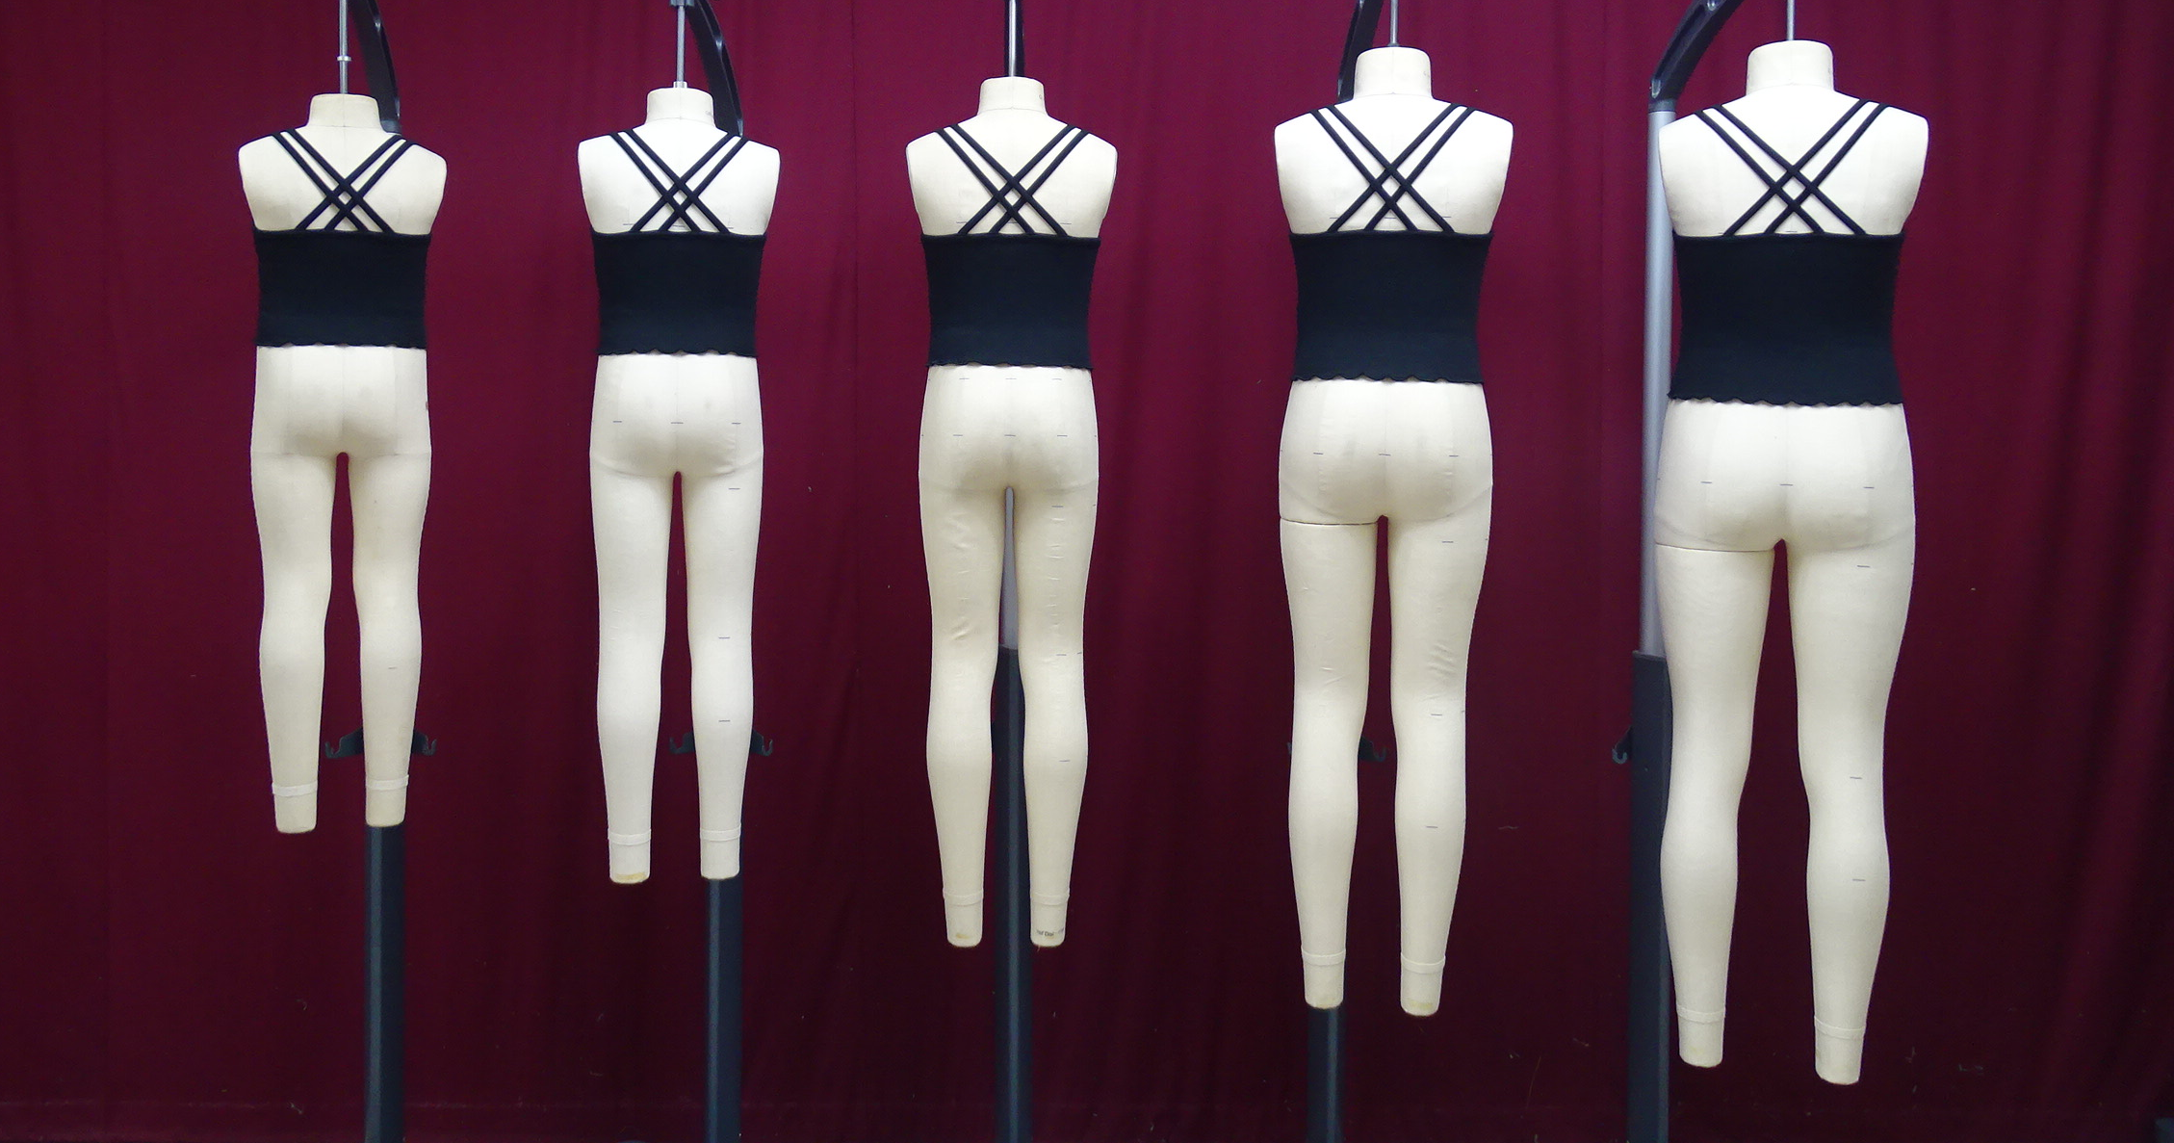
PID# PR4Z46, Vendor Grading and Technical Approval, Approved, 3 of 4
XS S M L XL
TD Comments:
Strap length looks longer than APC, especially in S, M, and L. (L strap looks longer than XL) . Since we have reduced the strap length from APC, it cannot be longer than APC. Please re-check the strap length again in the flat garment and check whether garment is put correctly on dummy. Back bodice should be placed on MNQ’s landmark.

